Slide 2
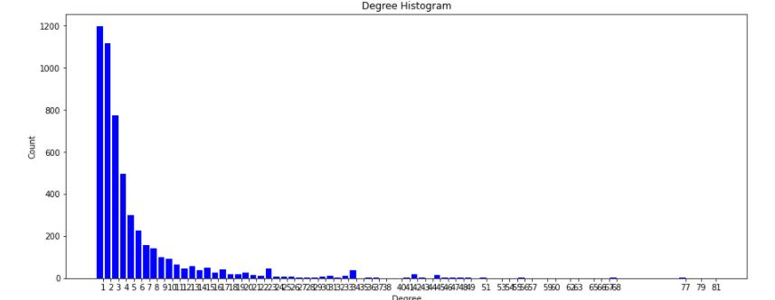
Comparative Literature Review of Four Community Detection Algorithms
Dataset used
Algorithms used
Arxiv GR-QC
Nodes: 5242
Edges: 14496
Average Degree: 5.5307
Average clustering coefficient: 0.6055
Algorithm | Reference | Complexity
Girvan-Newman (GN) | Girvan and Newman (2002) | O(m²n)
Louvain Method (LM) | Blondel et al. (2000) | O(n log n)
Greedy Modularity (GM) | Clauset et al. (2004) | O(n²)
Clique Percolation Method (CPM) | Palla et al. (2005) | O(n²)
Degree Distribution
Table 1: Degree Distribution
Table 2: Algorithms used

Slide 3
Girvan-Newman
Louvain Method
Greedy Modularity Algorithm
Clique Percolation Method
Starting Algorithm as it is the most commonly used community detection method
Shifted to LM as a faster method was needed
Modularity Maximization which Accounts for smaller communities
Algorithm showing overlaps
High Computation times
Smaller Communities
were hidden
Checked for Overlapping
communities

Slide 4
Evaluation Parameters
Due to limited benchmark and ground truth data networks were evaluated based on:
Modularity
F1 score for those available
CPU Execution time
Number of Communities
System used
MacBook Pro 2016
2 GHz Dual-Core Intel Core i5 Processor

Slide 5
Girvan-Newman
Applications
Widely used as a benchmark algorithm for various sectors
Fast community detection algorithm
Nodes should have the same expected degree and community size
Procedure
1) Calculate edge betweenness for every edge in the graph.
2) Remove the edge with highest edge betweenness.
3) Calculate edge betweenness for remaining edges.
4) Repeat steps 2–4 until all edges are removed

Slide 6
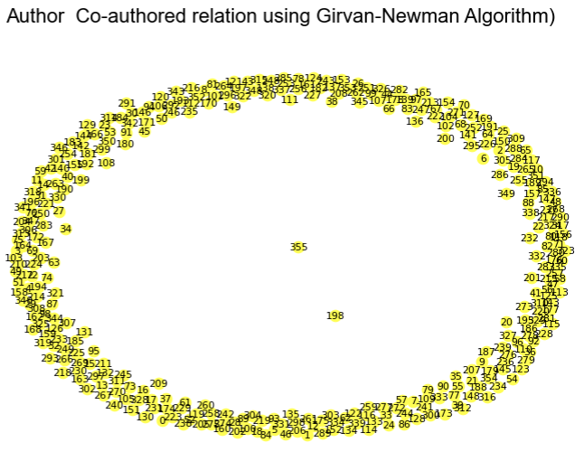
Results
Literature suggests that this algorithm is more viable when community sizes are the same and sparsely populated
As found community sizes differ meaning it is not a realistic portrayal of our dataset
Confirms the assumption of the literature as data is very densely populated and has overlapping communities (Network 4)
Hence low modularity (0.176)
Execution time is extremely high (344s) due to the size of the and because edge betweenness needs to be repeatedly recalculated
Modularity 0.176
Communities 356
Execution Time 344s
Use Louvain to check
Network 1: Girvan-Newman
Notes:
Although the GN algorithm is widely employed as a benchmark algorithm, it's more suited to smaller synthetic networks and not real-world datasets as these are characterised by largely heterogeneous degree distributions and heterogeneous community sizes. This is because all nodes need to be sparsely populated and have the same expected degree.
That defect is shown by the fact that the 356 communities found had 0.176 modularity. Moreover, it took 344.66 seconds to execute the commands.
This confirms the assumption of the literature as our dataset is very densely populated and has overlapping communities.
The GN algorithm suffers from the fact that it does not show a realistic topology of the real network. For these reasons, the GN benchmark cannot be considered as a good proxy for a real network.

Slide 7
Louvain Method
Applications
Reaches maximum modularity through hierarchical structure allows for more applications.
Suitable for real networks and much faster than other community detection algorithm and uses a local approach
Two-step Procedure
1) Searching for small communities through optimizing modularity locally.
2) Matches nodes that belong to the same community.
3) Builds a new network whose nodes are the communities.
4) Process is completed repeatedly.

Slide 8
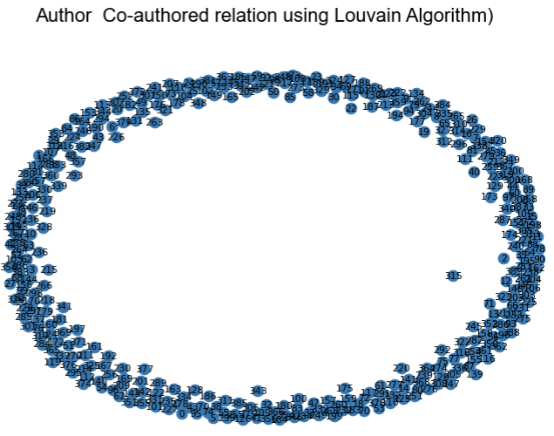
Results
Even though community sizes fluctuate, modularity increases to 0.863, with 393 communities being found, showing a more favorable result confirming the assumptions
Extremely efficient network with execution time 3.86s
However, Blonde et al. suggests that the bigger a network becomes the more difficult it is to detect smaller communities due to resolution limit.
This limits reliability.
Modularity 0.863
Communities 393
Execution Time 3.86s
Use FGM to check
Network 2: Louvain Algorithm
Notes:
Here, modularity increases to 0.863, with 391 communities being found showing a more favourable result.
Although modularity is high, while analysing the communities it was found that the community sizes fluctuate with some being extremely large or small.
Blondel et al. talk about a theoretical limitation of modularity (the quality measure the algorithm optimizes), the resolution limit, which says that as we increase the size of the network, the minimal size of a detected community also increases i.e. as we get larger and larger networks, we are unable to uncover small communities
This limit hinders the efficiency of modularity as it causes communities to be disconnected as modularity may 'hide' smaller communities. These disconnected communities were identified in the analysis showing communities that are weakly connected.
This may be due to this method usually being used for weighted networks as it's based on local information to improve quality. As this did not apply to our dataset the quality of the network is not satisfactory.
In terms of computation time, the Louvain method is very efficient and took 30 seconds to compute the commands.

Slide 9
Fast Greedy Modularity
Applications
Improved modularity maximization algorithm as it joins networks rather than building new ones
Applied to various networks mainly Social, biology and transportation Networks
No prior information of dataset is needed
Procedure
1) Finds changes in modularity resulting from combining communities
2) It then selects the pair that reaches the largest gain modularity
3) Each node is seen as a single community before it gets implemented

Slide 10
Greedy Algorithm
F1 Score 0.029
Communities 426
Execution Time 102.37
Modularity 0.812
Results
Compared to GN algorithm this updated version accounts for modularity deficiencies with this one allowing for the detection of smaller communities
This is shown by the algorithm giving good divisions of communities and finding smaller communities (426)
Furthermore, the computation time has also vastly improved with this version only taking 102.37 seconds.
Although, the FGM shows to be a suitable algorithm with modularity being 0.812.
Use CPM to check

Slide 11
Clique Percolation Method (CPM)
Applications
Most efficient and common overlapping community detection algorithm
Mainly applied to Social, biology and collaboration Networks
Works on unweighted and weighted real networks
Procedure
Input: Network N, clique size – k
1) Find. all k-cliques in network N.
2) Construct a Clique graph where each node represents clique identified in step one
3) Each connected component represents a community in the clique graph

Slide 12
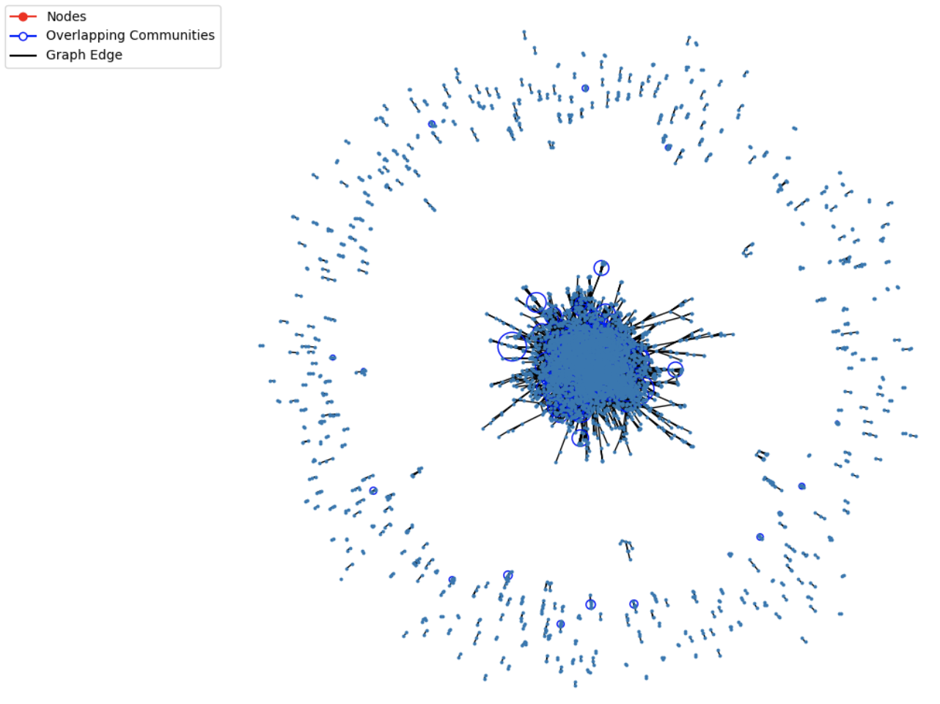
Communities 311
Execution Time 18
F1 Score
Results
When k is set to be greater than 4 this algorithm found 311 communities in 18 seconds
The resulting community structure shows various overlapping clusters
The issue is that the value of k determines how many cliques the structure has where too many cliques may lead to deficiencies.
When k > 2 our model produces 2299 cliques meaning vertices have been left out
Network 4: Clique Percolation Method

Slide 13
Final Analysis
 | Modularity | F1 Mean Score | CPU Times(s) | Communities
Girvan-Newman | 0.176 | NA | 344.66 | 356
Louvain Algorithm | 0.861 | NA | 3.86 | 394
Greedy Modularity | 0.812 | 0.029 | 102.37 | 426
Clique percolation | NA | 0.1775 | 18 | 311
Table 3: Algorithms used
Louvain Method yields highest modularity (0.861). and fastest CPU execution time (3.86s) meaning it is best method based on criteria despite the resolution limit and the incapability to account for overlapping algorithms.
Fast Greedy modularity is a close second with slightly lower values 0.812 modularity and 102.37s execution time. However this method managed to account for the smaller communities (426).

Slide 14
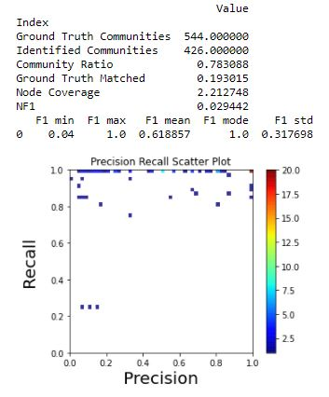
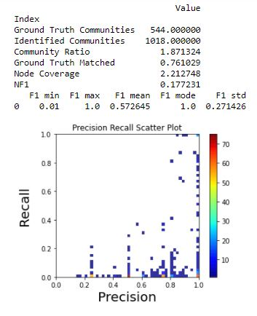
Normalized F1-communities
To assess the performances of a community detection algorithm we compare the output with given ground-truth communities by using computationally expensive metrics (i.e., Normalized Mutual Information).
We calculated NF1 for Greedy Modularity and Clique Percolation.
Table 5: GM vs CPM Benchmark
Table 6: CPM vs Label Propagation Benchmark

Slide 15
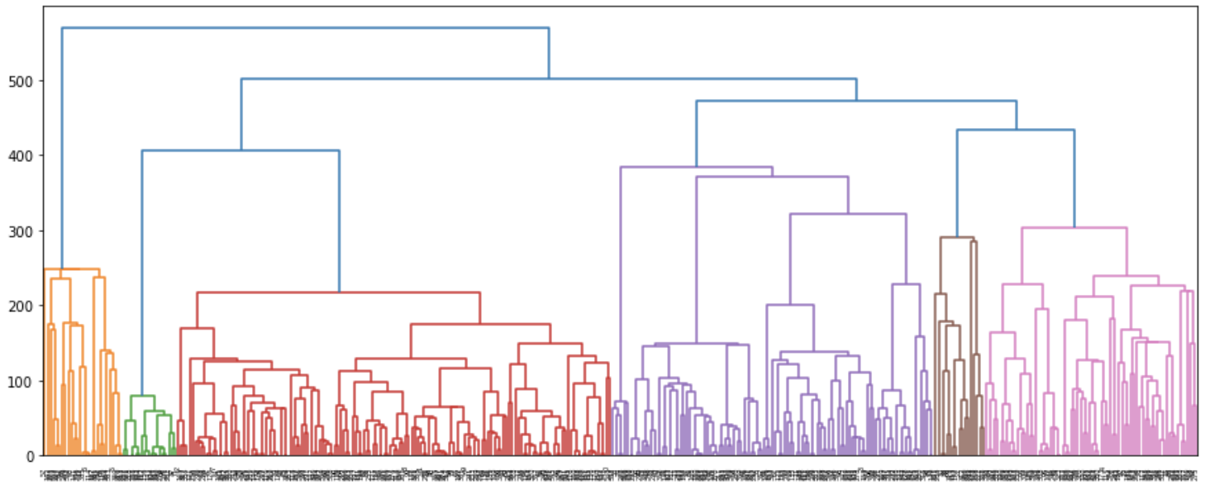
Louvain Method Dendrogram
Although, the Louvain Method is chosen as the most suitable algorithm table 3 shows its hierarchical community structure where the presence of overlapping and smaller communities being hidden the bigger the dataset becomes evident.
Table 4: Louvain Method Dendrogram showing the hierarchical community distribution

Slide 16

Conclusion
The literature regarding modularity-based algorithms assumed that there are various problems concerning the resolution, which was the case in our Girvan-Newman network (Low modularity due to density) hence it is not acceptable.
Although, the results revealed the Louvain method, Greedy modularity, and the CP algorithms to be acceptable based on the evaluation criteria, especially in terms of computation time and modularity, there are still concerns regarding the resolution limit with Louvain method as many communities were not shown.
Furthermore, it was discovered that there are various overlapping communities meaning the methods may not be the most efficient options for even larger datasets.
Using different algorithms of community detection namely the Louvain algorithm, Girvan-Newman algorithm, Greedy Modularity and Clique based algorithms clearly depicts that the first one is far more efficient — specially with respect to focus towards finding many Co-Authors are involved with Author for paper publication.
However, usage/efficiency might differ from one domain to another depending on the use cases.

Slide 17
References
A. Clauset, M. Newman, and C. Moore, “Finding community structure in very large networks,” Physical Review E, vol. 70, no. 6, p. 66111, 2004
Blondel, J. Guillaume, R. Lambiotte, and E. Lefebvre, “Fast unfolding of communities in large networks,” Journal of Statistical Mechanics: Theory and Experiment, p. P10008, 2008
M. Girvan and M. Newman, “Community structure in social and biological networks,” PNAS, vol. 99, no. 12, p. 7821, 2002
Palla et al. – Uncovering the overlapping community structure of complex networks in nature and society
Schult, D., 2020. Networkx/Networkx. [online] GitHub. Available at: <https://github.com/networkx/networkx/blob/master/networkx/algorithms/community/modularity_max.py> [Accessed 11 November 2020].
J. Leskovec, J. Kleinberg and C. Faloutsos. Graph Evolution: Densification and Shrinking Diameters. ACM Transactions on Knowledge Discovery from Data (ACM TKDD), 1(1), 2007.

